Slide 1
GEHC SDT Weekly Status Report
03/23/17

Slide 2
Open Actions
Action item | Owner | Forum | Expected Closure Date | Actual Closure Date | Owner Comment | Status
Mobility Team or tiger team to be formed to resolve all CLICK mobile issues. | Rohit/Gopi | Jan’ 17 Workout | TBD |  | Monitoring the debug logs which are activated for 20 FE’s in production. | In Progress
Performance issues: SDT Booking and Architecture Assessment. | Hita/Andrey/Urmila/Chandra | Jan’ 17 Workout | 28-Feb-2017 |  | Identified 4 more performance assessment which needs to be analyzed. | In Progress
Ownership on Tickets/Process adherence(Agile Mechanism) | Suvarna/Sathyaraj | Jan’ 17 Workout | Ongoing |  |  | In Progress
GEHC to check and confirm on L1 support - on call support | Chandra/CG | Jan’ 17 Workout | TBD |  | Discussion held with GCC team and now GE to discuss and come up with the plan. | In Progress
CLICK DB access for CG team GE to setup a separate call to discuss | Chandra | WSR meeting | TBD |  | GE got DB backup access via ftp from Click and Server Objects (SO) DB is backed up every day | In Progress

Slide 3
Weekly Snapshot – 03/23/17
Health of the Engagement
Highlights
CLICK R2.1 Speed up Re-Booking Process functionality have been deployed in SB3 for 6 EU templates.
CLICK SDT Mobile new release v2.5 deployment completed successfully and new release is available on GE app store.
SDT Dev Instance Realignment(SB1,SB3)
Deployment of Release 1.3.1 is successfully implemented.
Demo on VPT tool UI creation in Predix environment.
GREEN
Risk / Issues / Challenges
Help Needed
Without the CLICK environment(Server) details its difficult to understand the data flow from CLICK mobile to CLICK SO(Service Optimization) servers - Rohit/Chandra
Need resolution to infrastructure related queries and common forum to resolve - Chandra
Need support on performance related issues on CLICK side – Urmila

Slide 4
Focus Area Updates
Focus Areas | Owner | Status | Comments
Mobile Sync Issues | CG Team | In Progress | Yet to receive end to end environments details from CLICK team which was requested but they denied due to policy reasons. CG mobile team to share the document on background mode activation. Debug log activated for all 20 FE’s and Monitoring FE’s debug log.
SDT Booking Performance Issues | CG Team | In Progress | Identified four more areas of improvement on performance assessment. On filtering of tasks - instead of filtering the tasks after retrieving from the Click DB, Tasks needs to be filtered prior to their retrieval from the Click DB. Analysis on the function PartsPickDependency, To suggest if any code changes can be done to improve the performance of the SDT application. The code to find out if the ES LS logic in the function ’GetESLSByStandardOperation’ whether it can be implemented locally instead of making a Click web service call. In the function GetTasksResponseOrBumpCheck need to check whether it’s still in use in the SDT application as the concept of Bumping tasks is no more in use.
Release Management | CG Team | Ongoing | Release check list was created and it is updated in our Release readiness check call.
Incident Management | CG Team | Ongoing | Streamlining incidents w.r.t CLICK support cases Problem ticket creation process finalized. Incidents reported in this week are closed.
Support and Development Process streamlining | CG Team | Ongoing | Agile metrics identified and tracked through Rally. Ensuring all email communication to have incident ticket created. Internal defect tracker is maintained to track the QA/UAT defects and owners defined for each defect.

Slide 5

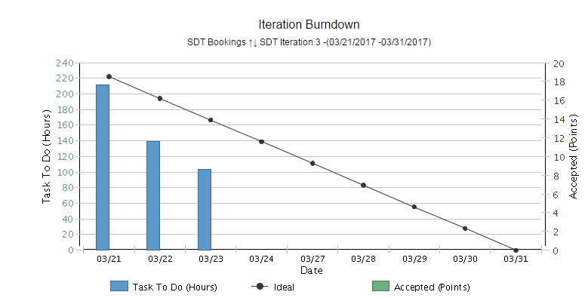
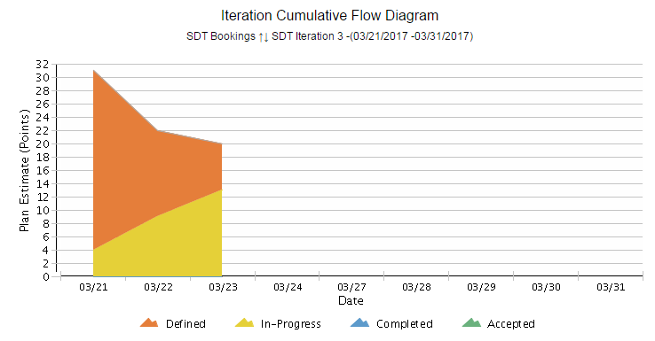
Agile Metrics - Development
Iteration Burndown Chart:
During Sprint planning added technical user stories in the sprint accepted by product owner.
Prioritized users stories by Product owner based on the performance analysis.
Iteration Cumulative Flow Diagram
First day of the Sprint . 5 user stories added in the sprint backlog.
2-3 user stories added on day 2 after performance assessment discussion.
Team started working on 5 user stories which shows the tasks are in progress.
SDT Iteration 4 – 21st Mar to 31st Mar ‘17
Inferences
Inferences

Slide 6
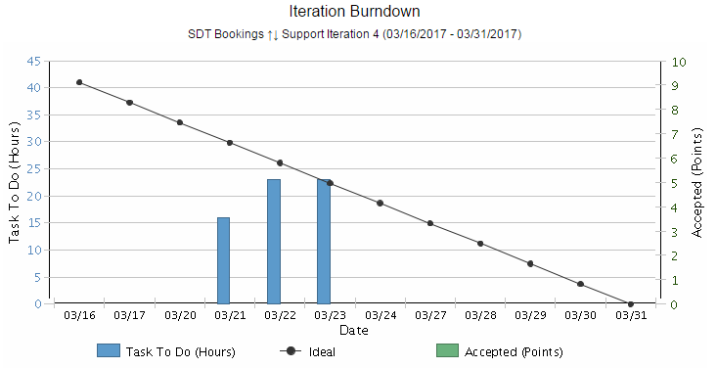
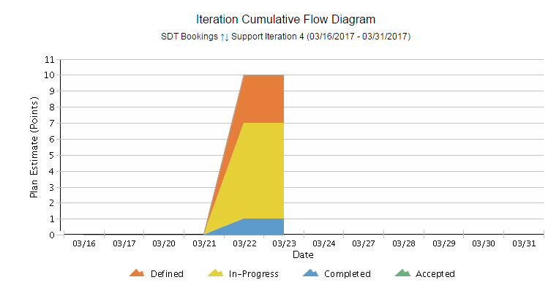
Agile Metrics - Support
SDT Click, Support and Incidents
Support Iteration 3 – 16th Mar to 31st Mar ‘17
Inferences
Iteration Support Burndown Chart:
Support activities keep on added up on a daily basis based on the support tickets that we receive. Hence there’s a mismatch with ideal.
End of the sprint, all tickets are closed and all the user stories are accepted by Product owner.
Iteration Cumulative Flow Diagram
The tasks related to Release 2.1 and 2.2 and 3 incidents are completed
9 incident tickets are in-progress
2 tickets are in defined state.

Slide 7
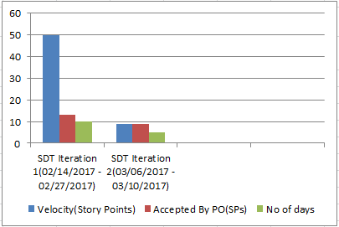
Agile Metrics – Velocity Chart
SDT
Inferences
Velocity Chart
SDT Iteration 1
Velocity of team:50 story points
Accepted By PO: 13 story Points
US85 and US 97 –Accepted by PO as these user stories are already deployed in production as part of release 1.3.1
Iteration length: 10 days(2 weeks)
SDT Iteration 2
Velocity of team: 9 story points
Accepted By PO: 9 story Points
Iteration length: 5 days(1 week)

Slide 8
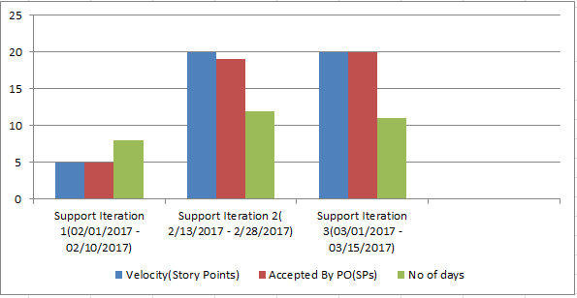
Agile Metrics – Velocity Chart
Support
Inferences
Velocity Chart
Support Iteration 1
Velocity of team:5 story points
Accepted By PO: 5 story Points
Iteration length: 8 days
Support Iteration 2
Velocity of team:20 story points
Accepted By PO: 19 story Points
Iteration length: 12 days
Support Iteration 3
Velocity of team:20 story points
Accepted By PO: 20 story Points
Iteration length: 11 days

Slide 9
Agile Metrics – Resource Utilization
Weekly resource Utilization(20th Mar 2017 – 24th Mar 2017)

Slide 10
Incident Update
Status | Last Week | This week
Active | 0 | 0
Awaiting 3rd Party | 16 | 16
Awaiting User Info | 5 | 5
Resolved | 1 | 9
Resolved - Awaiting Problem | 2 | 2
Closed | 35 | 35
Total | 59 | 67
8 incident tickets are resolved/closed
16 Awaiting 3rd party
5 Awaiting User Info
Inferences

Slide 11
Incident Tickets
Incident Management
Incident # | Module |  | Key Words |  | Status |  | Queue Wait time
INC1370193 | SDT Mobile |  | Mobile sync Issue |  | Awaiting 3rd Party |  | 3 months ago
INC1446914 | SDT Mobile |  | Mobile sync Issue |  | Awaiting 3rd Party |  | 2 months ago
INC1447037 | SDT Mobile |  | Mobile sync Issue |  | Awaiting 3rd Party |  | 3 months ago
INC1454094 | SDT Mobile |  | Mobile sync Issue |  | Awaiting 3rd Party |  | 4 months ago
INC1463913 | SDT Mobile |  | Mobile sync Issue |  | Awaiting 3rd Party |  | 5 months ago
INC1464027 | SDT Booking |  | Click Issue |  | Awaiting User Info |  | 7 weeks ago
INC1477114 | SDT Booking |  | Mobile Sync Issue |  | Awaiting User Info |  | a month ago
INC1480772 | SDT Mobile |  | Mobile sync Issue |  | Awaiting User Info |  | a month ago
INC1735928 | SDT Schedule |  | Click Issue |  | Awaiting 3rd Party |  | 22 days ago
INC1736222 | SDT Schedule |  | Click Issue |  | Awaiting 3rd Party |  | 21 days ago
INC1738700 | SDT Module |  | Click Issue |  | Awaiting 3rd Party |  | 21 days ago
INC1747182 | SDT Mobile |  | Click Issue |  | Awaiting 3rd Party |  | 16 days ago
INC1754593 | SDT Module |  | Click Issue |  | Awaiting 3rd Party |  | 14 days ago
INC1766606 | SDT Module |  | Mobile Sync Issue |  | Awaiting 3rd Party |  | 8 days ago
INC1777886 | SDT Module |  | Click Issue |  | Awaiting 3rd Party |  | 3 days ago
INC1778499 | SDT Module |  | Click Issue |  | Awaiting 3rd Party |  | 3 days ago
INC1779626 | SDT Module |  | Click Issue |  | Awaiting 3rd Party |  | 3 days ago
INC1781463 | SDT Module |  | SDT Booking issue |  | Awaiting User Info |  | a day ago
INC1782655 | SDT Schedule |  | App launch |  | Awaiting User Info |  | 24 hours ago
INC1784270 | Siebel-SDT Schedule |  | Owner Update |  | Awaiting 3rd Party |  | 9 hours ago
INC1784702 | Siebel-SDT Schedule |  | Owner Update |  | Awaiting 3rd Party |  | 4 hours ago
Problem Management
Problem # | Module | Keyword |  | Status |  | Incident #
PRB0045855 | SDT Booking | Google API |  | Open |  | INC1371682, INC1389372, INC1357120
PRB0045895 | SDT Booking | Email Activity |  | Open |  | INC1285226
PRB0045475 | SDT Booking | Performance - Connectivity |  | Known Error / Pending CA |  | INC1310582

Slide 12
THANK YOU

